Slide 1


BDAT 1004 DATA PROGRAMMING
GROUP 5 PROJECT
PRESENTATION

Slide 2

CONTENT
PROJECT SUMMARY
TEAM MEMBERS
SYSTEM ACHITECTURE
DATA ACQUISITION
DATA STORAGE
DATA EXPLORATION
DATA VISUALIZATION

Slide 3
PROJECT SUMMARY
The project involved a seamless acquisition of data from a remote URL source using Python within a Jupyter Notebook. Through the implementation of pseudo-batch processing, the acquired data was efficiently stored in a MongoDB cloud database. Leveraging the capabilities of Microsoft Azure, the project ensured secure and scalable storage on the cloud. In-depth data exploration and analysis were conducted using Jupyter Notebook, accompanied by insightful visualizations generated with Matplotlib.
To enhance accessibility, a Flask web application was integrated, allowing for the display of dynamic visualizations on the web. The project was rounded off with the generation of comprehensive reports, providing a clear and detailed account of the analysis results. Overall, the project showcased a robust end-to-end data processing pipeline, highlighting proficiency in data science and engineering, cloud technologies, and web application development.
RETURN

Slide 4
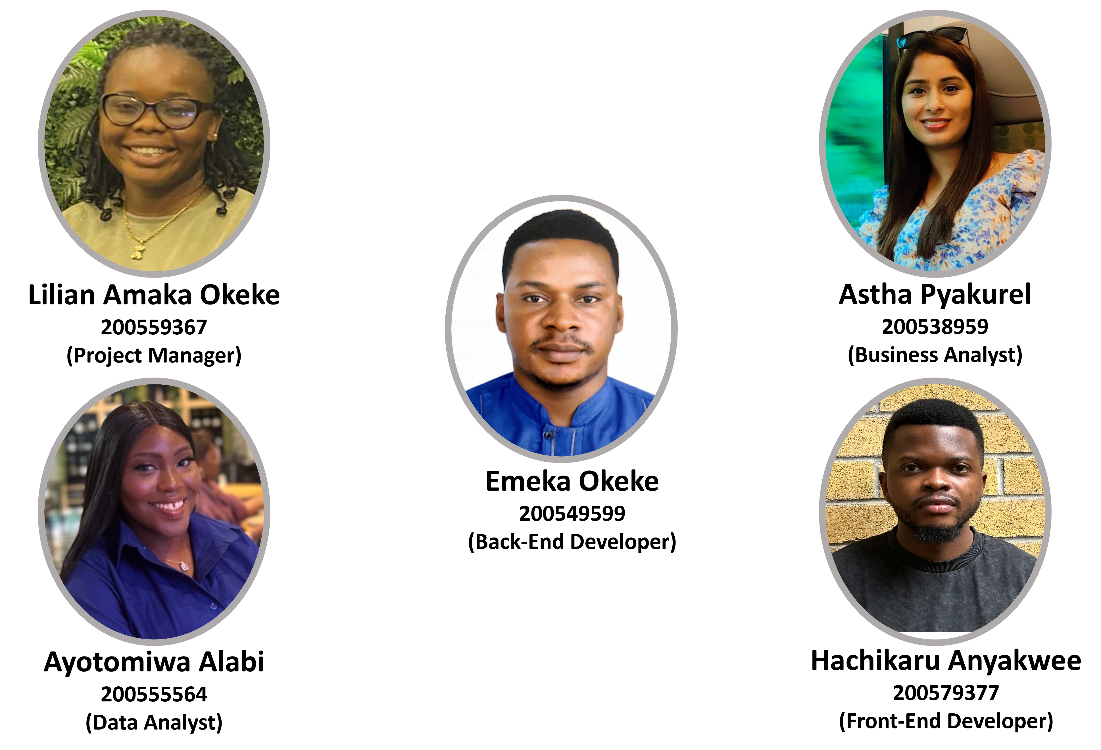
TEAM MEMBERS
RETURN

Slide 5
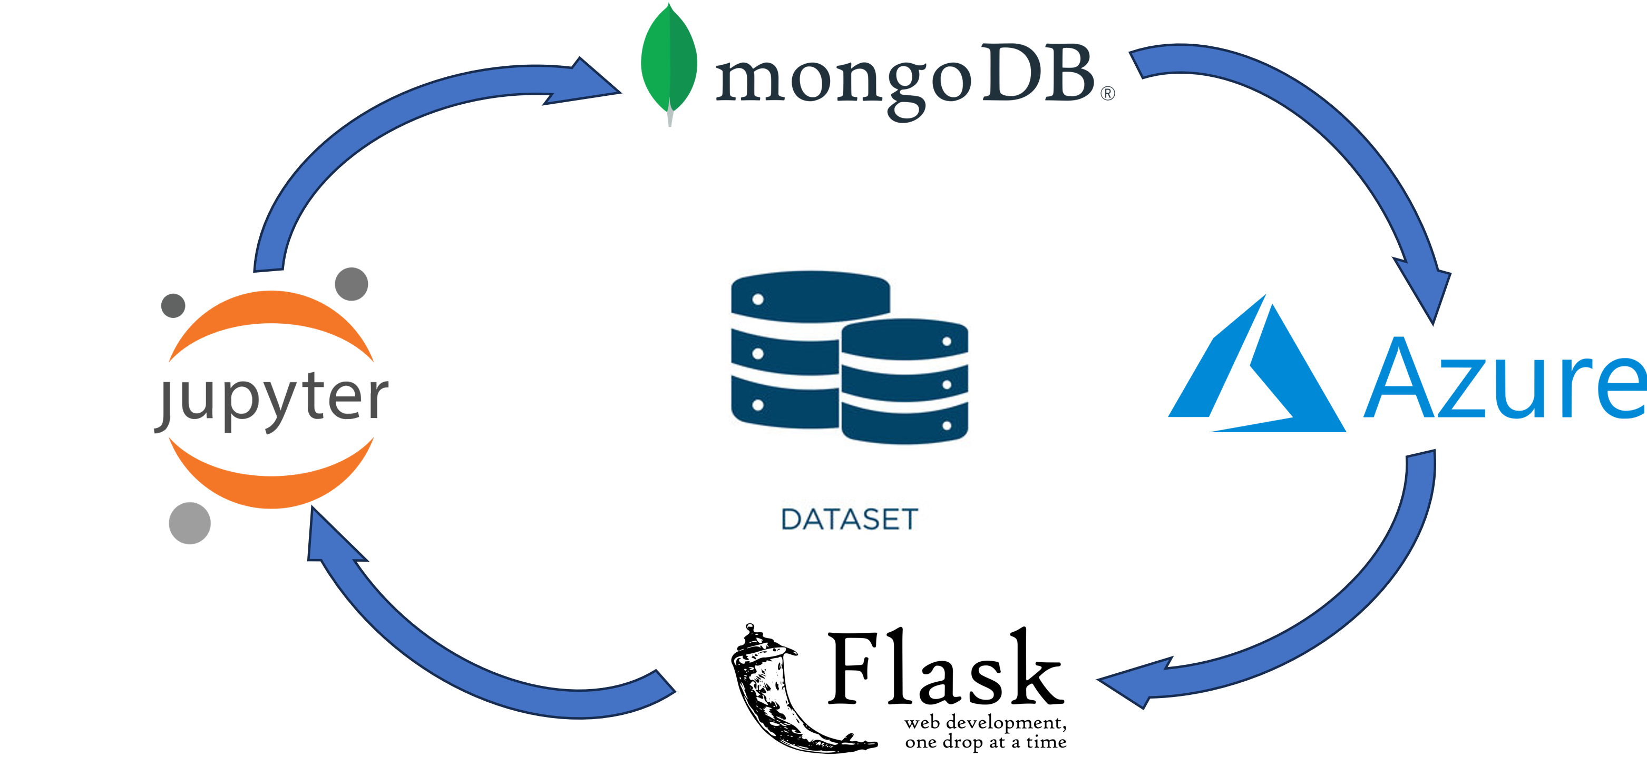
SYSTEM ARCHITECTURE
RETURN

Slide 6
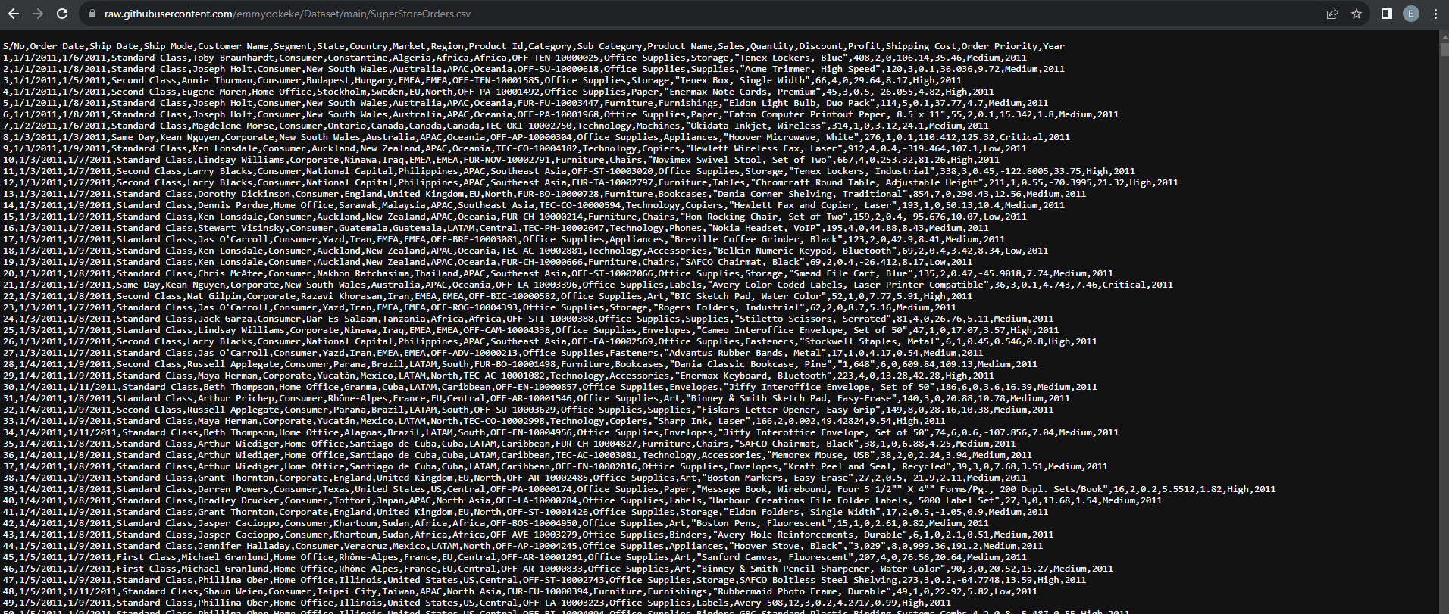
DATA AQUISITION
RETURN

Slide 7
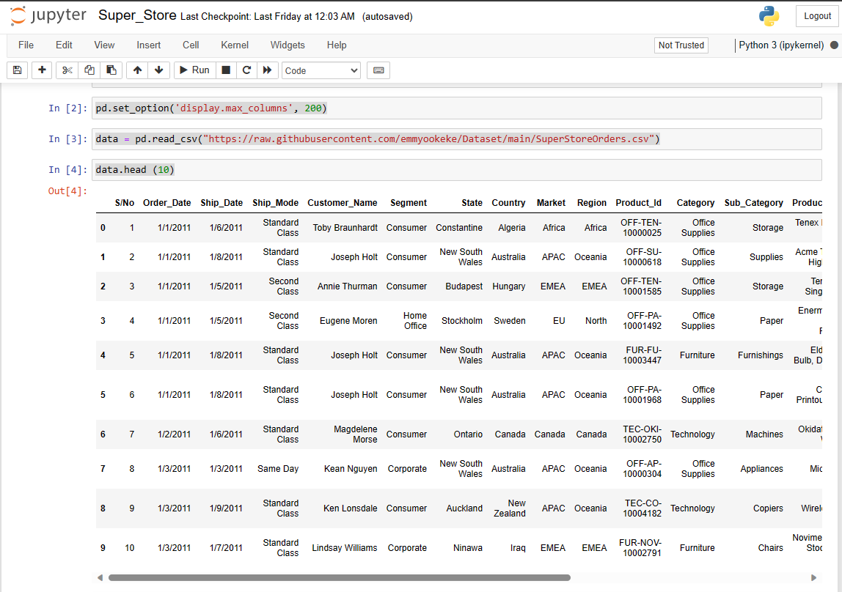
DATA AQUISITION
RETURN

Slide 8
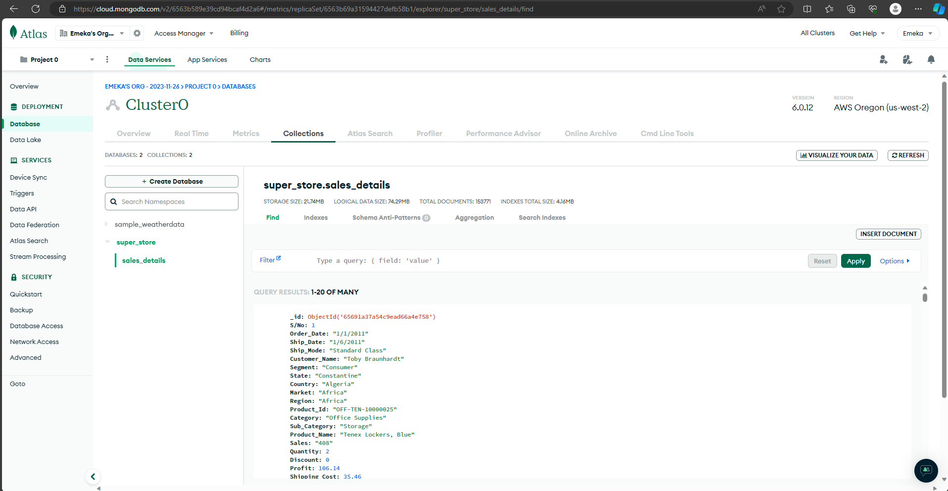
DATA STORAGE
RETURN

Slide 9
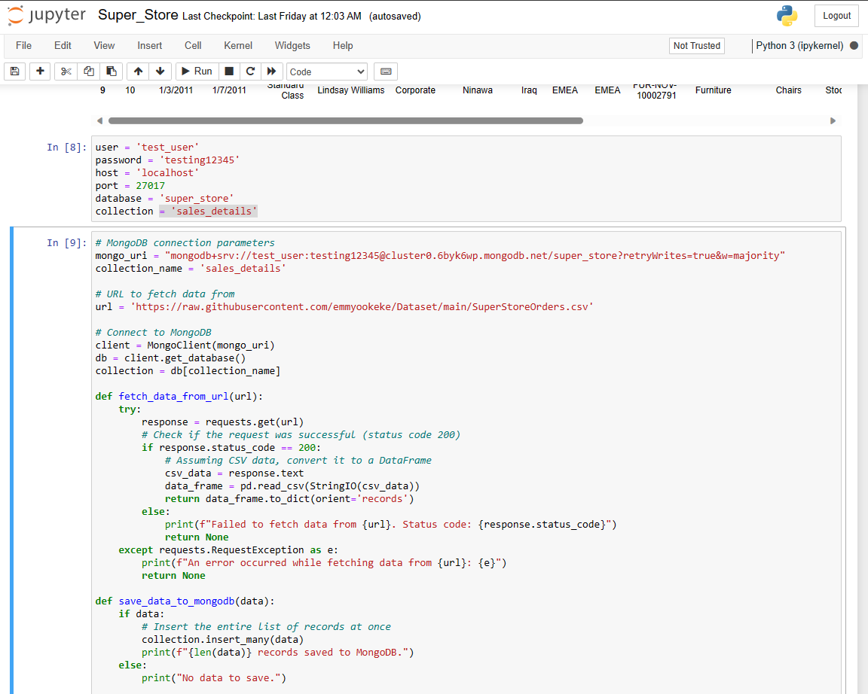
DATA STORAGE
RETURN

Slide 10
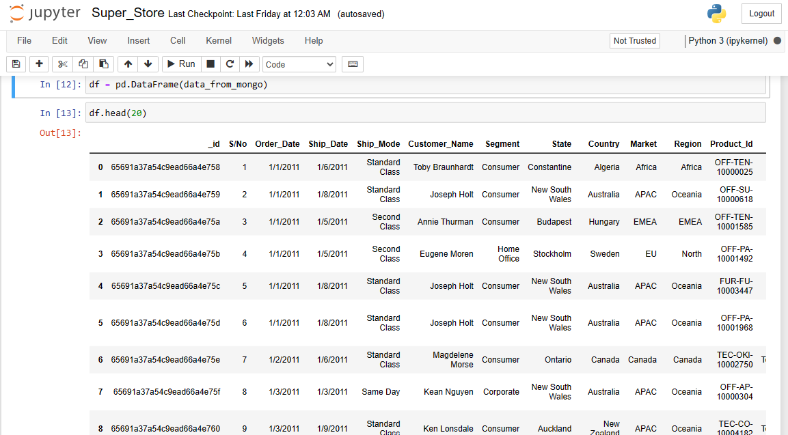
DATA EXPLORATION
RETURN

Slide 11
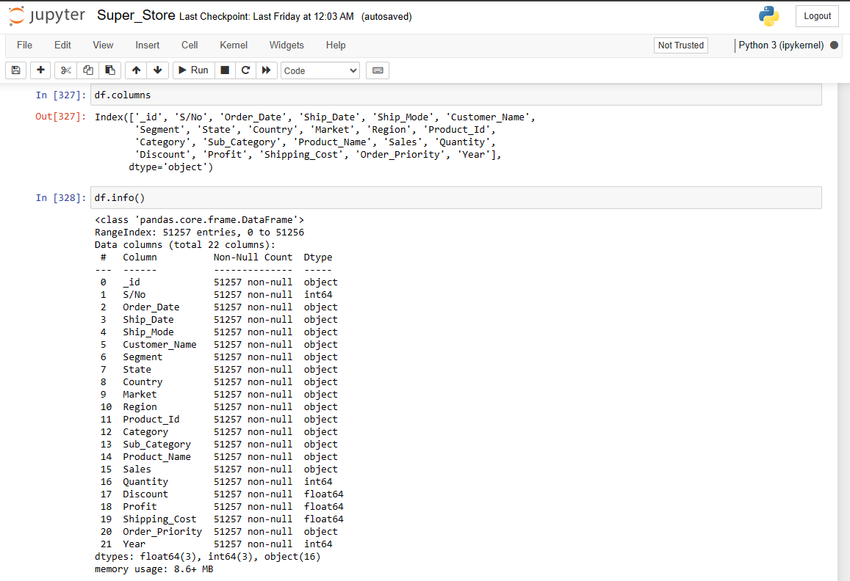
DATA EXPLORATION
RETURN

Slide 12
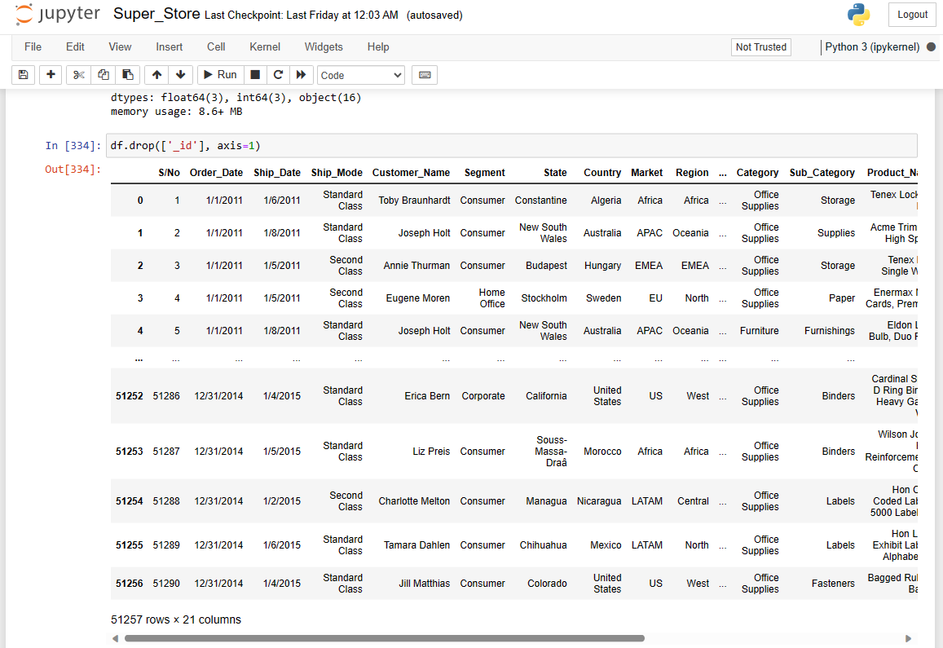
DATA EXPLORATION
RETURN

Slide 13
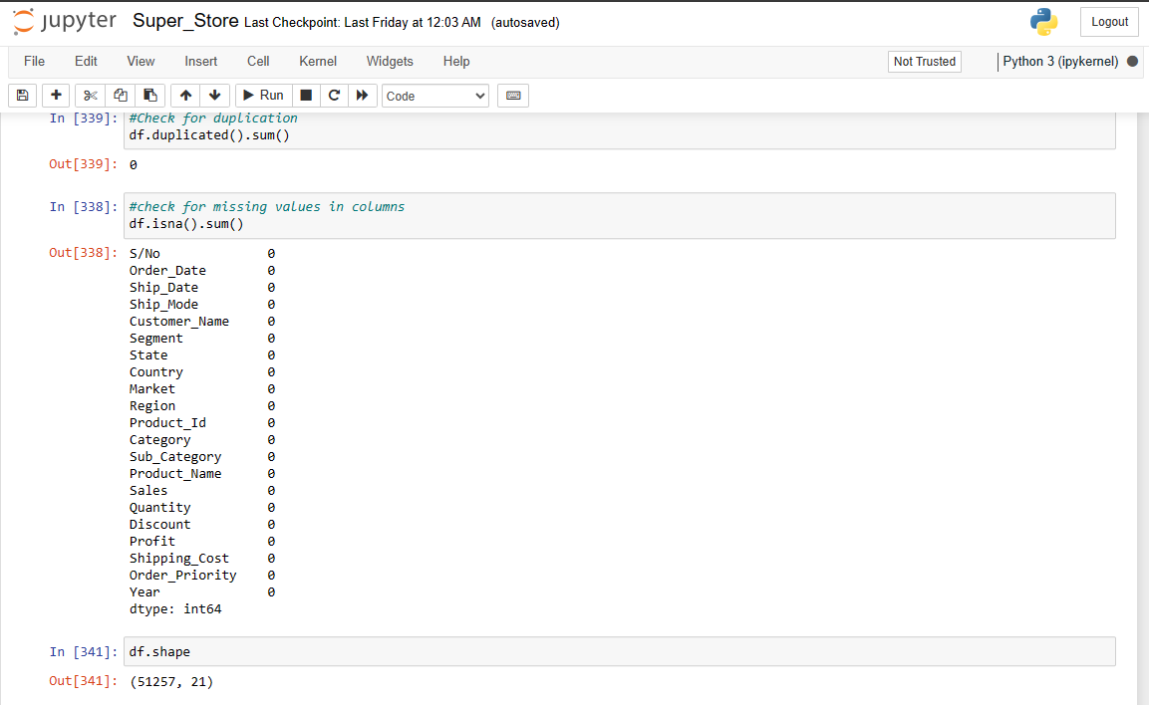
DATA EXPLORATION
RETURN

Slide 14
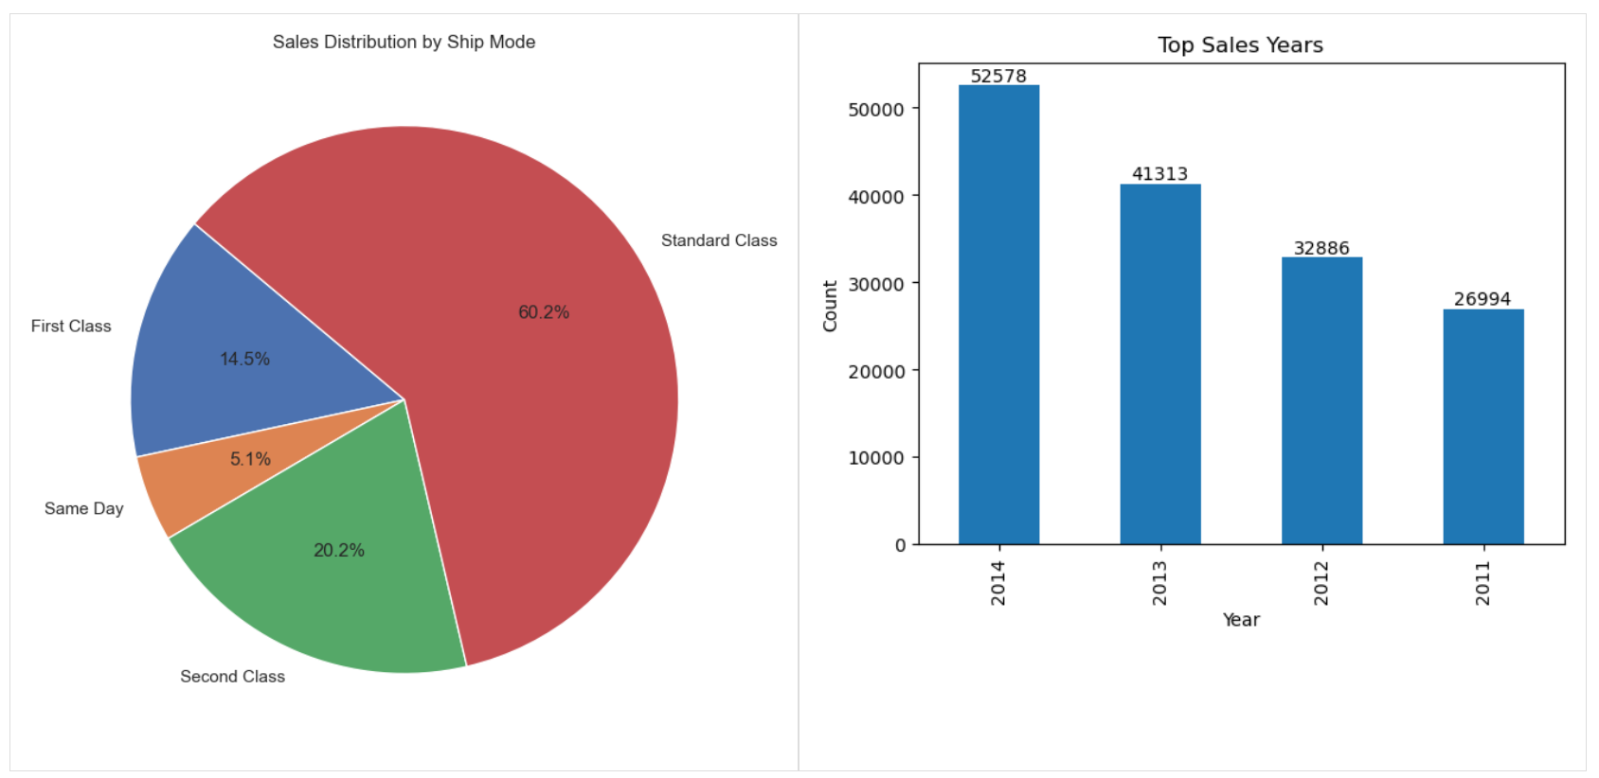
DATA VISUALIZATION
RETURN

Slide 15
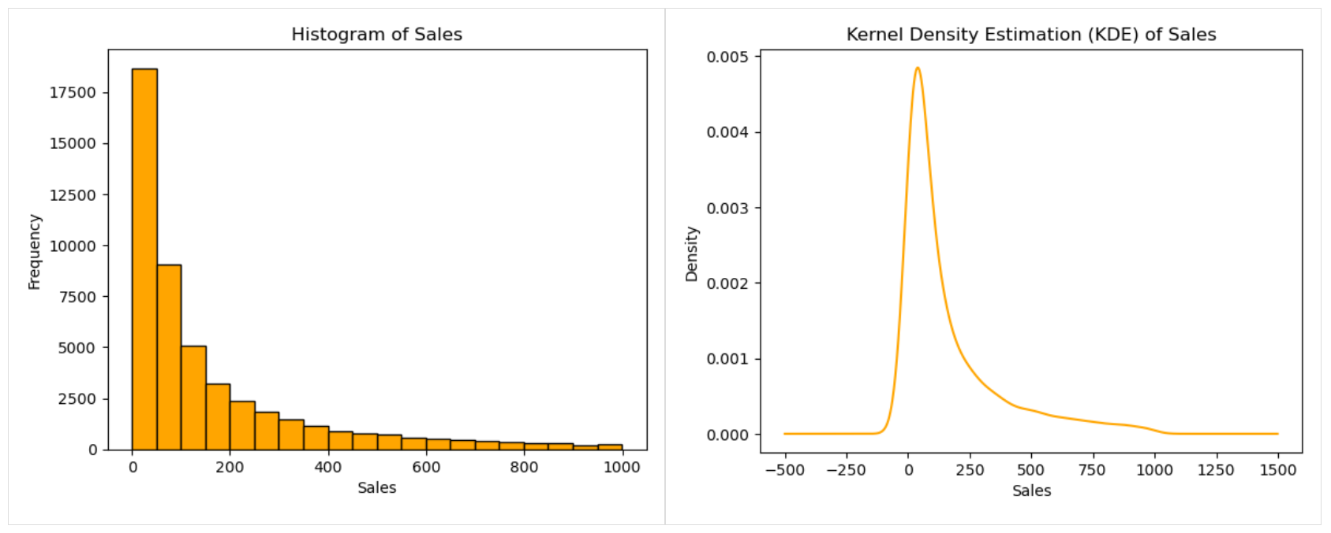
DATA VISUALIZATION
RETURN

Slide 16
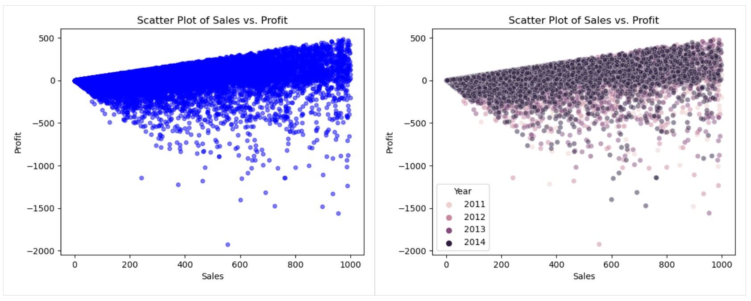
DATA VISUALIZATION
RETURN

Slide 17
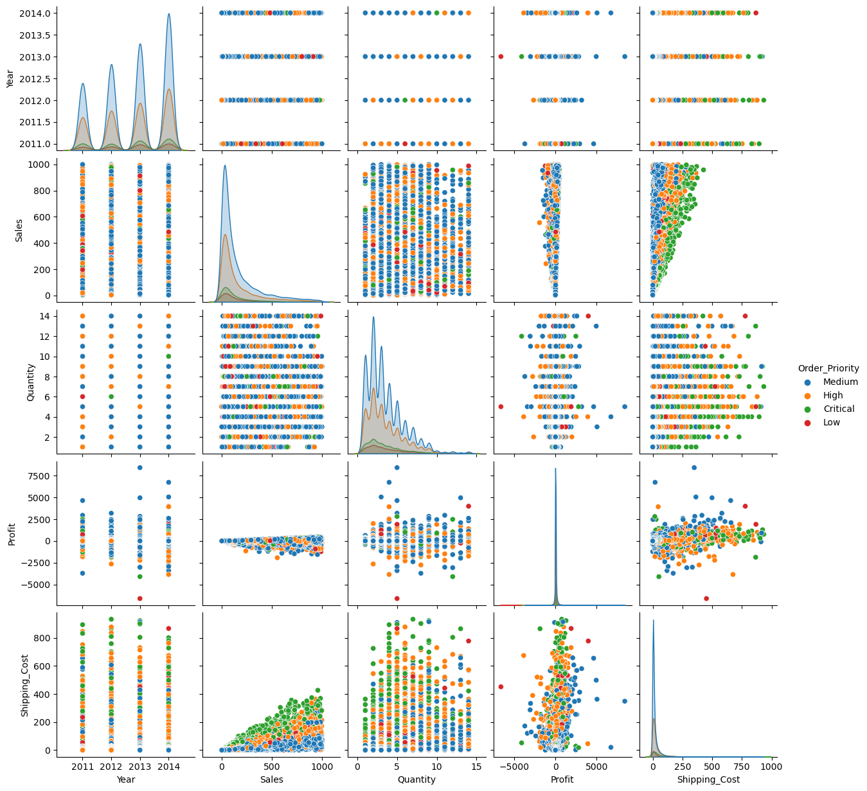
DATA VISUALIZATION
RETURN

Slide 18
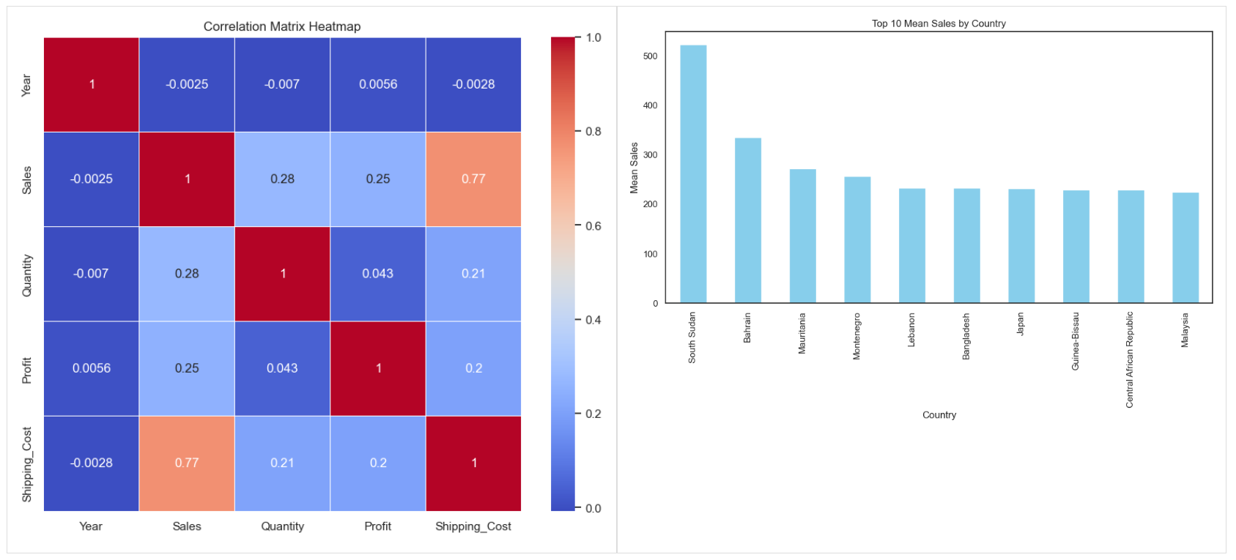
DATA VISUALIZATION
RETURN

Slide 19
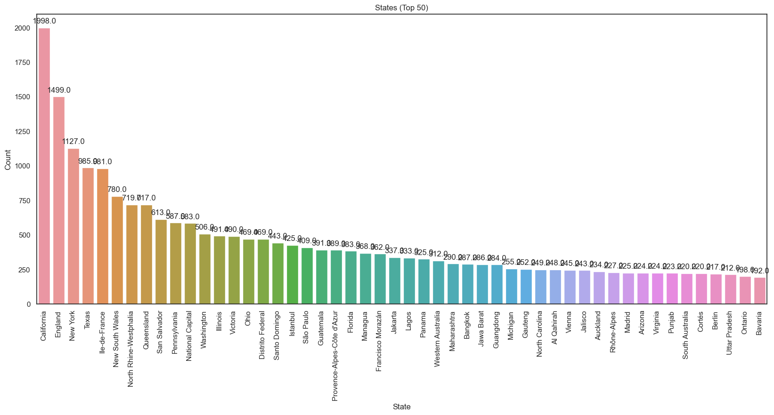
DATA VISUALIZATION
RETURN

Slide 20
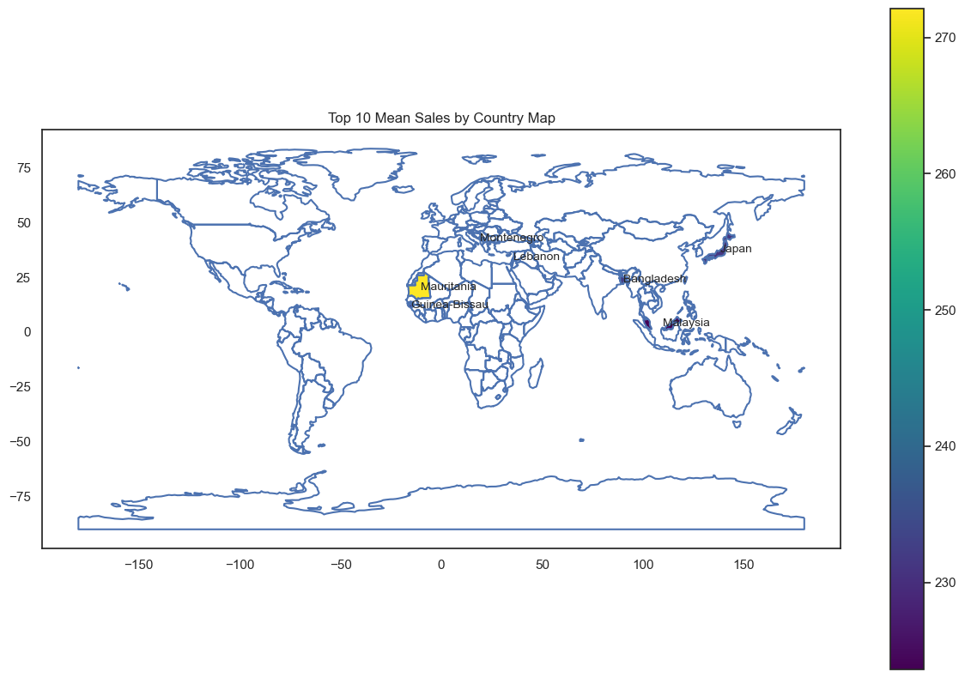
DATA VISUALIZATION
RETURN

Slide 21
THANK YOU
RETURN

